Slide 1
Sprint 4: Presentation
Jodan Elysee, Kevin Botwinick, Jack Kogut

Slide 2
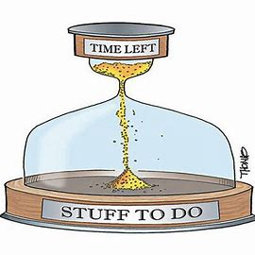
Challenges
Sprint 1 Challenges:
Time Management
Meeting with group members
Robot Testing
Sprint 2 Challenges:
Struggled with block code
Room availability
Sprint 3 Challenges:
Time Management
Robot Testing (Ramp)

Slide 3
Group member Roles
Jodan: Block Code and Gantt Chart Supervisor
Kevin: System Design Document Editor
Jack: Algorithm Management/Videographer

Slide 4
What we learned about software engineering
We learned what it feels like to be a software engineer. a software engineer is a person who applies the principles of software engineering to design, develop, maintain, test, and evaluate every sprint.
In software engineering it's important to work as a team and divide the tasks for a better result.
Software engineering also taught us the importance of time management and how important it is to manage time affectively.
The final takeaway from software engineering is it's ok to not get the answer right away it can take multiple tries until the software is done correctly.

Slide 5
What would we do differently
Better time management
Changing Roles
More attempts with robot on the 2nd and 3rd Sprint.
Try to make the robot go faster.
Try to get the robot to follow inside the tape for longer.

Slide 6
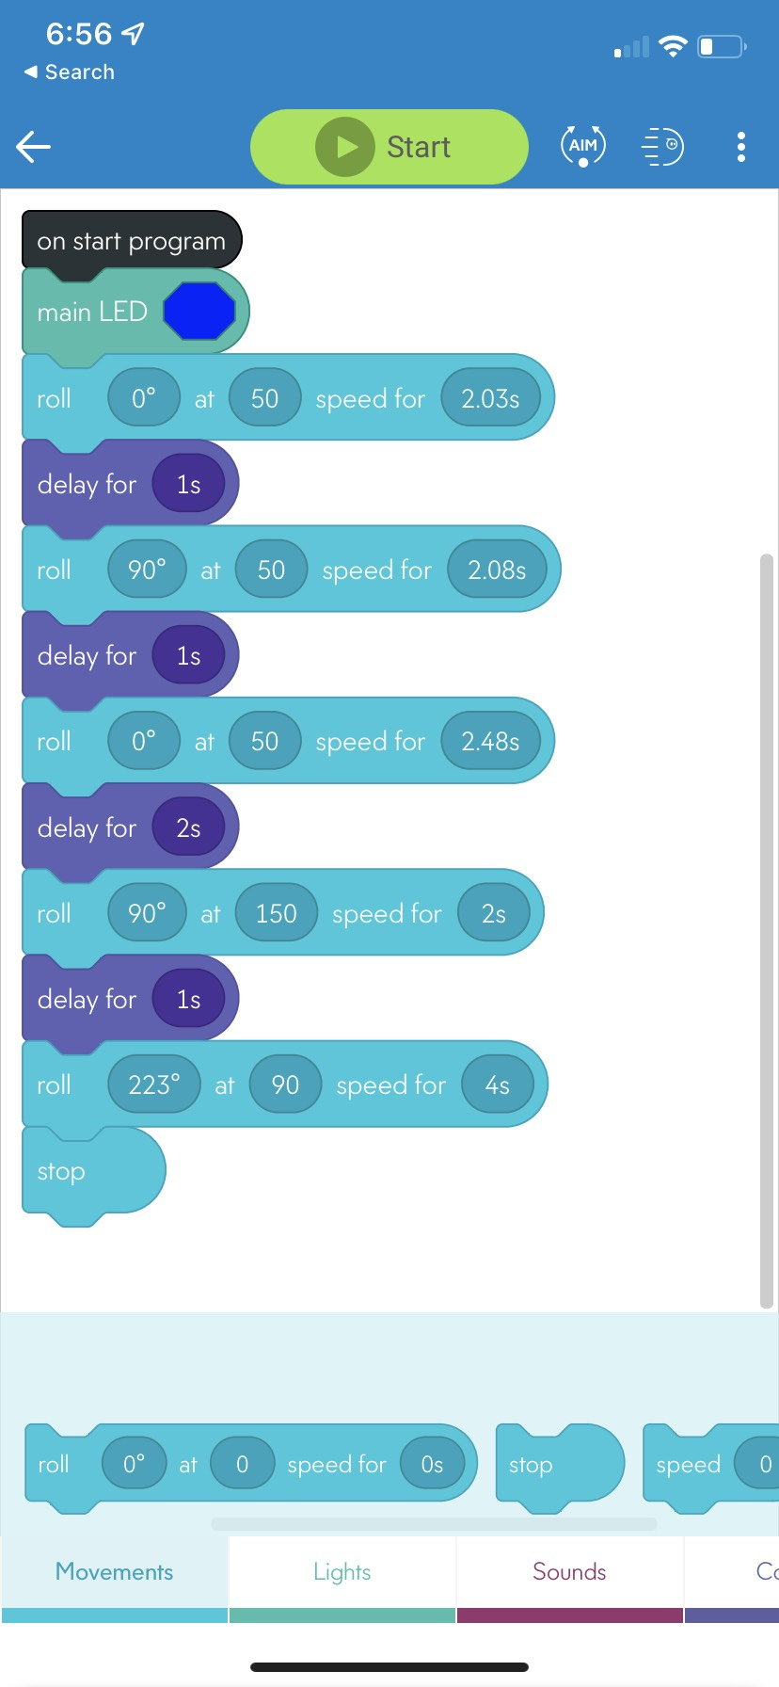
Agility Block Code

Slide 7
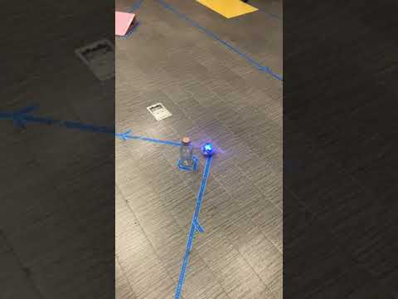
Agility Video

